Slide 1


D
epression and bullying
etection system in social media
นายกาลัญญู ตันบิน 6010110616
อาจารย์ที่ปรึกษา รศ.ดร.พิชญา ตัณฑัยย์

Slide 2

OUTLINE
Statement of the problems
ที่มาและความสำคัญ
NEED HELP MANAGING PROJECTS?
Presentations are communication tools that can be used as demonstrations, lectures, speeches, reports, and more. It is mostly presented before an audience.

Slide 3






Statement of the problems
ปัญหาการกลั่นแกล้งของคนในสังคม
กลุ่มเพื่อน
สังคมที่ทำงาน
บนโลกออนไลน์

Slide 4


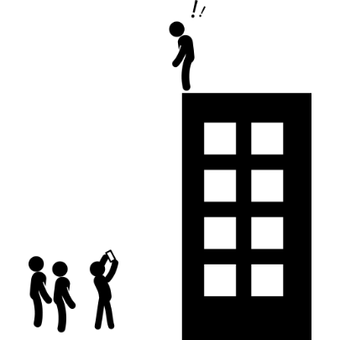

Statement of the problems
โรคซึมเศร้า
ปัญหาสุขภาพ
Depression
รับการรักษา

Slide 5
Statement of the problems
โรคซึมเศร้า
62%
11.5%

Slide 6

Statement of the problems
โรคซึมเศร้า
53,000 คน
ในแต่ละปี
มีคนพยายามฆ่าตัวตาย
4,000 คน
คนที่ฆ่าตัวตายสำเร็จมีถึง

Slide 7
Statement of the problems
สถิติผู้ใช้ Facebook ในไทย

Slide 8





Statement of the problems
Detect
BULLY
DEPRESSION

Slide 9
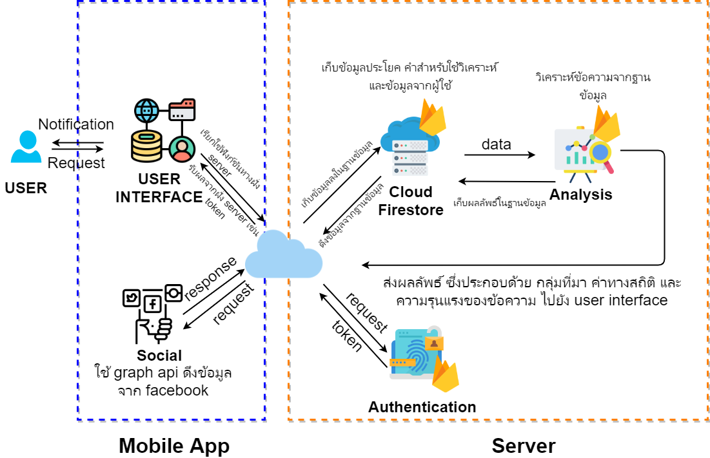
System Architecture

Slide 10
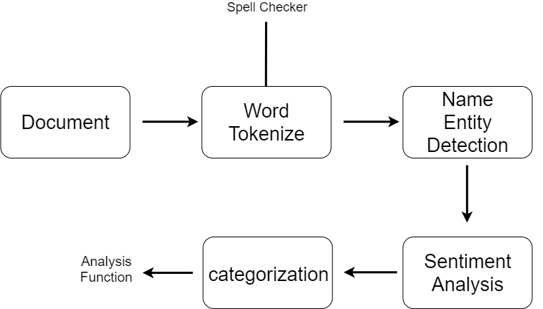
NLP (Natural Language Processing)
NLP Diagram

Slide 11
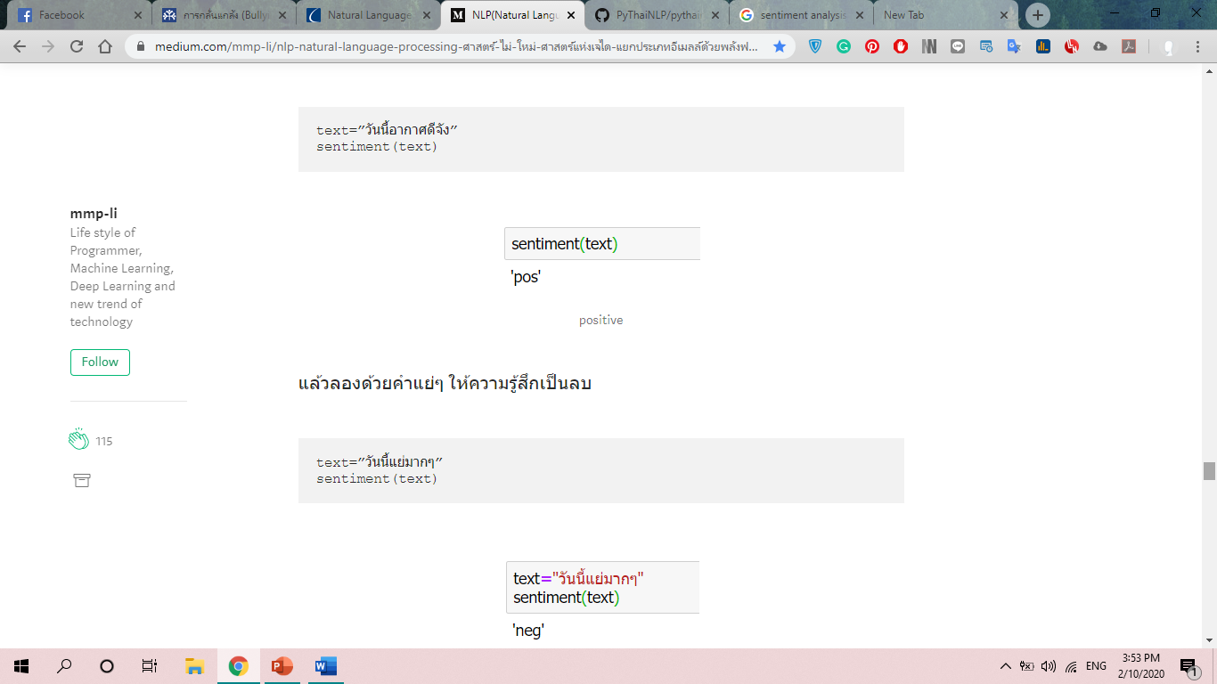
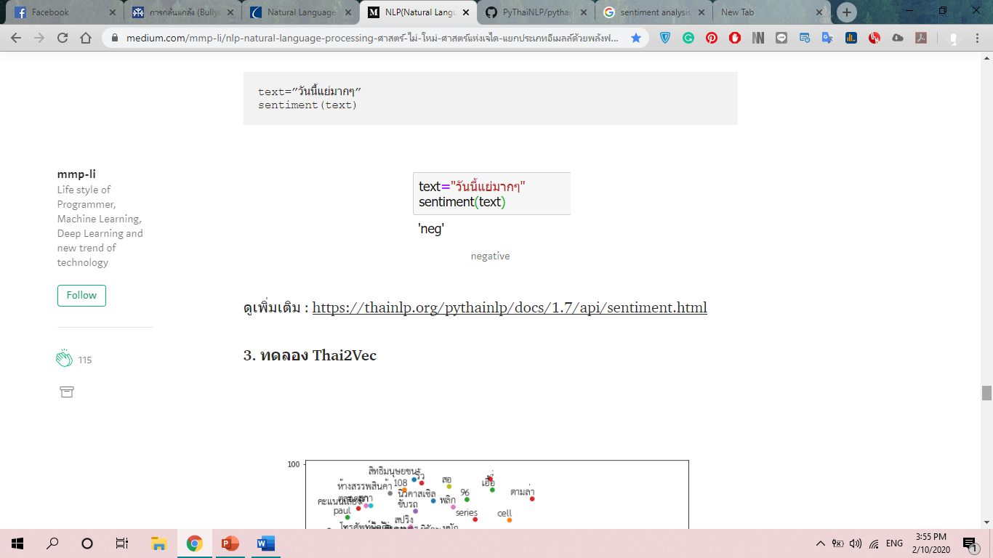
NLP (Natural Language Processing)
Sentiment analysis

Slide 12
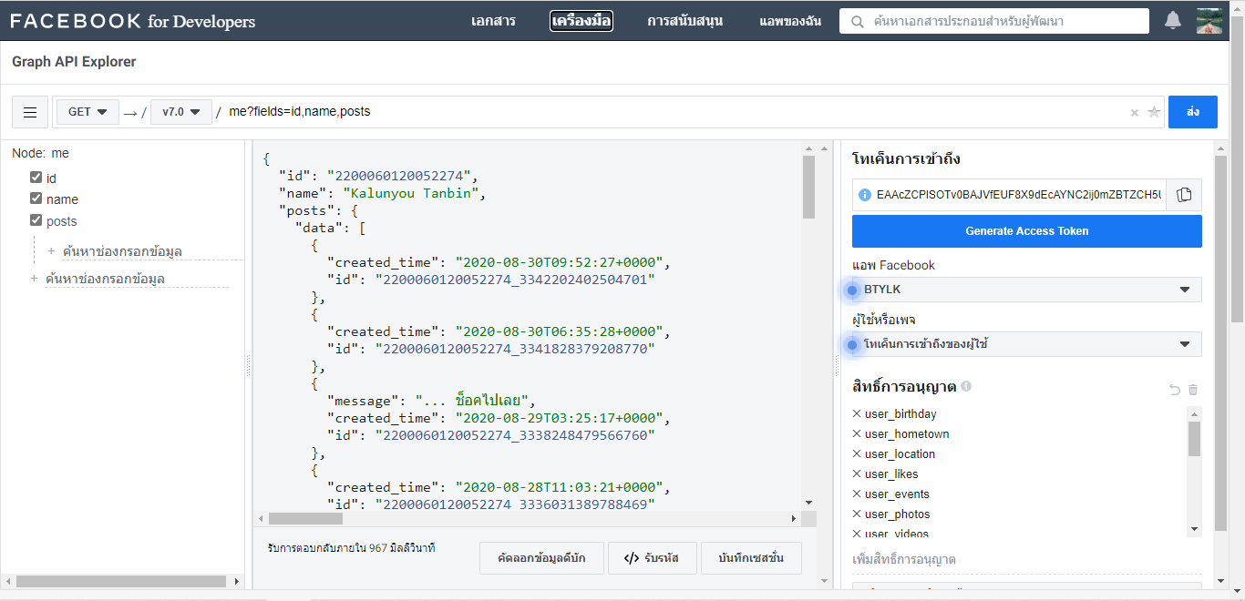
Graph API

Slide 13
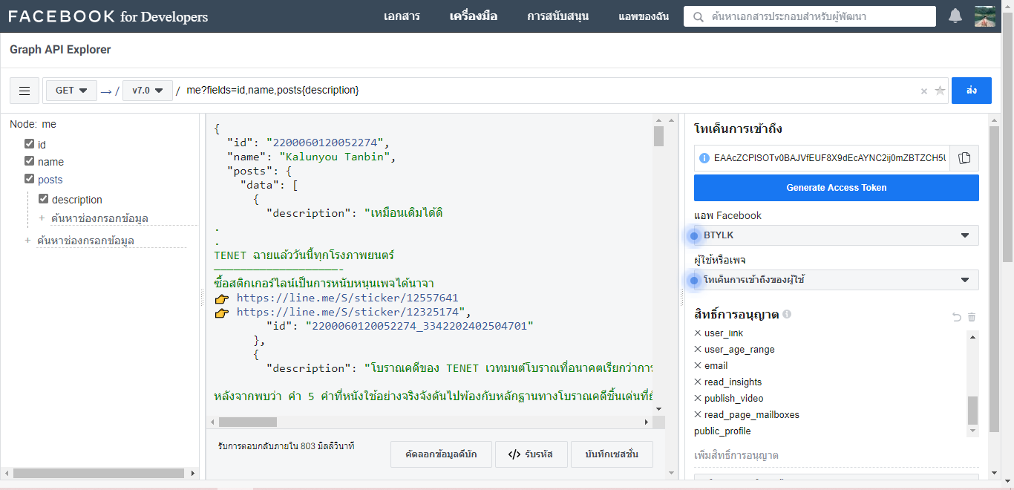
Graph API

Slide 14

Progress
คลังข้อมูลคำศัพท์ LST20 Corpus

Slide 15
Sort tasks based
on urgency.
MANAGE TIME BETTER WITH TIME BOXING TECHNIQUES.
USE WORKFLOW AND COLLABORATION TOOLS FOR ALL KINDS OF PROJECTS.
Presentations are communication tools that can be used as demonstrations, lectures, speeches, reports, and more. It is mostly presented before an audience.
Presentations are communication tools that can be used as demonstrations, lectures, speeches, reports, and more.

Slide 16

TaskWhiz
An intuitive productivity app for busy people

Slide 17
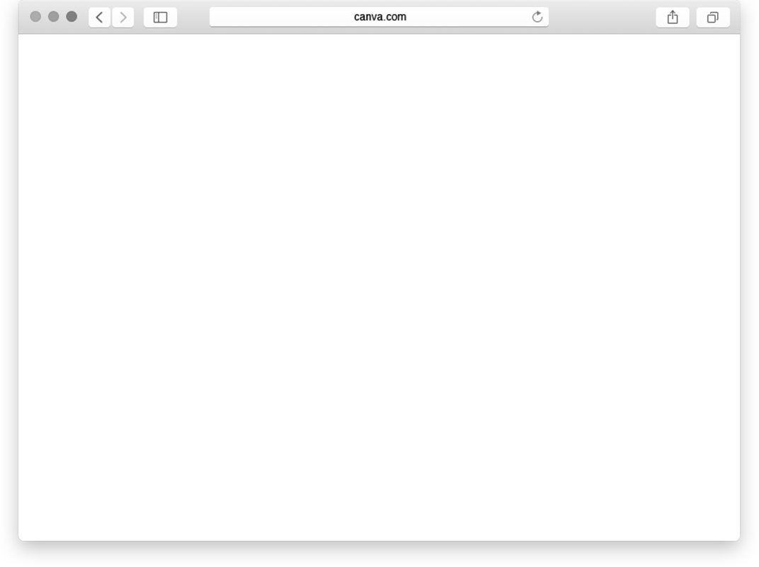

Getting started with TaskWhiz
Sign up, log in, and organize your tasks into manageable boards.

Slide 18
TaskWhiz Key Features
Presentations are communication tools that can be used as demonstrations, lectures, speeches, reports, and more.
It is mostly presented before an audience.

Slide 19
TaskWhiz Basic is free!
Get TaskWhiz Biz at $10/mo!

Slide 20

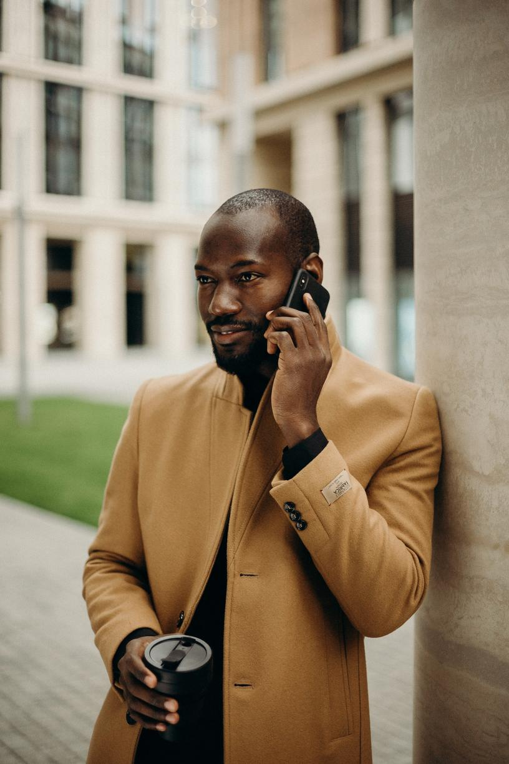
How to get TaskWhiz
Get the desktop app for Windows and Mac or the mobile app for iOS and Android.

Slide 21
For individual users
who want to achieve their work goals
For businesses that want to help their teams to be productive
Presentations are communication tools that can be used as demonstrations, lectures, speeches, reports, and more.

Slide 22
What our clients have to say
"I noticed a huge improvement on my workday when I started using TaskWhiz.
Now I can tackle deadlines with confidence!"
"Our team finished projects one week earlier on average last year thanks to TaskWhiz."
"The TaskWhiz interface is easy to use. My workday is not complete without it!"

Slide 23

Exciting
new features coming soon!
Create tasks and lists by voice.
Turn emails into tasks with one easy click.

Slide 24


The People Behind TaskWhiz
Andy Smith
Founder
Billie Moore
Lead Developer

Slide 25

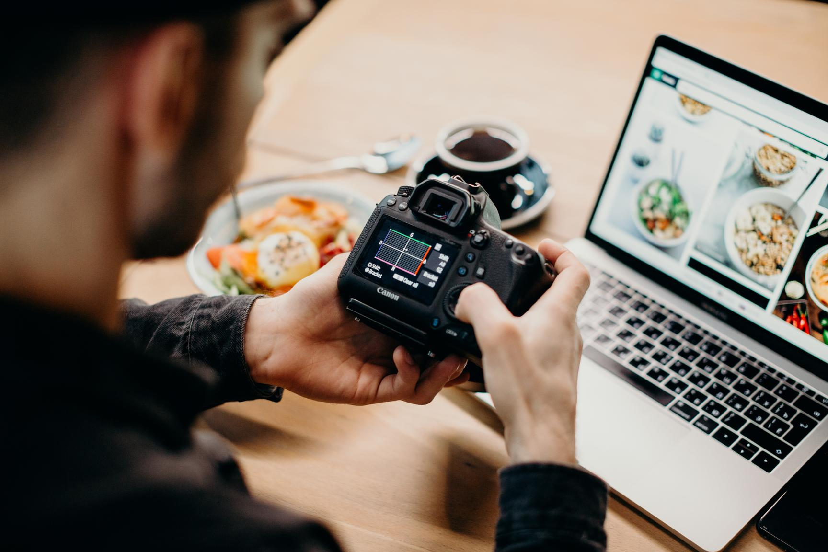

DOWNLOAD TASKWHIZ TODAY!

Slide 26
www.reallygreatsite.com
Questions? Comments?
Let us know!
hello@reallygreatsite.com
123-456-7890

